Slide 1

The Second Julia for ORNL Science Workshop: Welcome, Julia’s Value Proposition, Updates
William F Godoy
Computer Science and Mathematics Division
Advanced Computing Systems Research Section
Intelligent Systems and Facilities Group
June 20th 2024, JICS Auditorium Building 5100
https://ornl.github.io/events/jufos2024

Slide 2
Contents
Welcome
Julia’s value proposition for science: LLVM + Coordinated Ecosystem
Update: Efforts in HPC
Resources: where to get started?
Acknowledgments

Slide 3
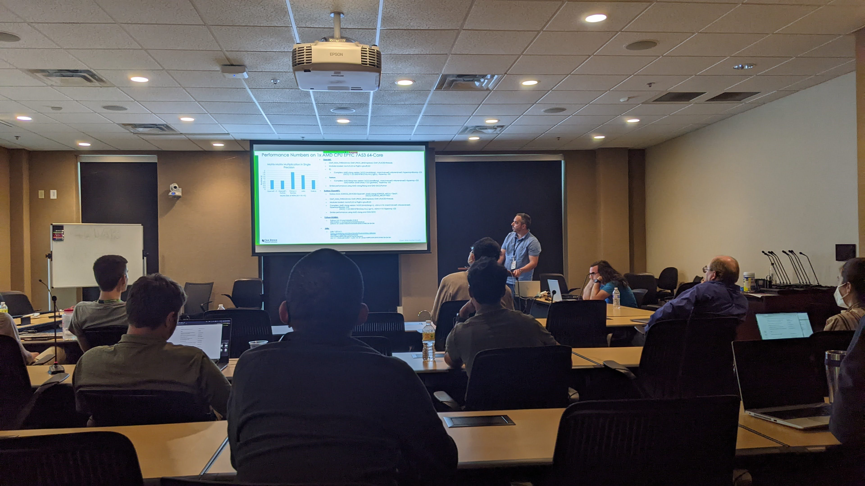
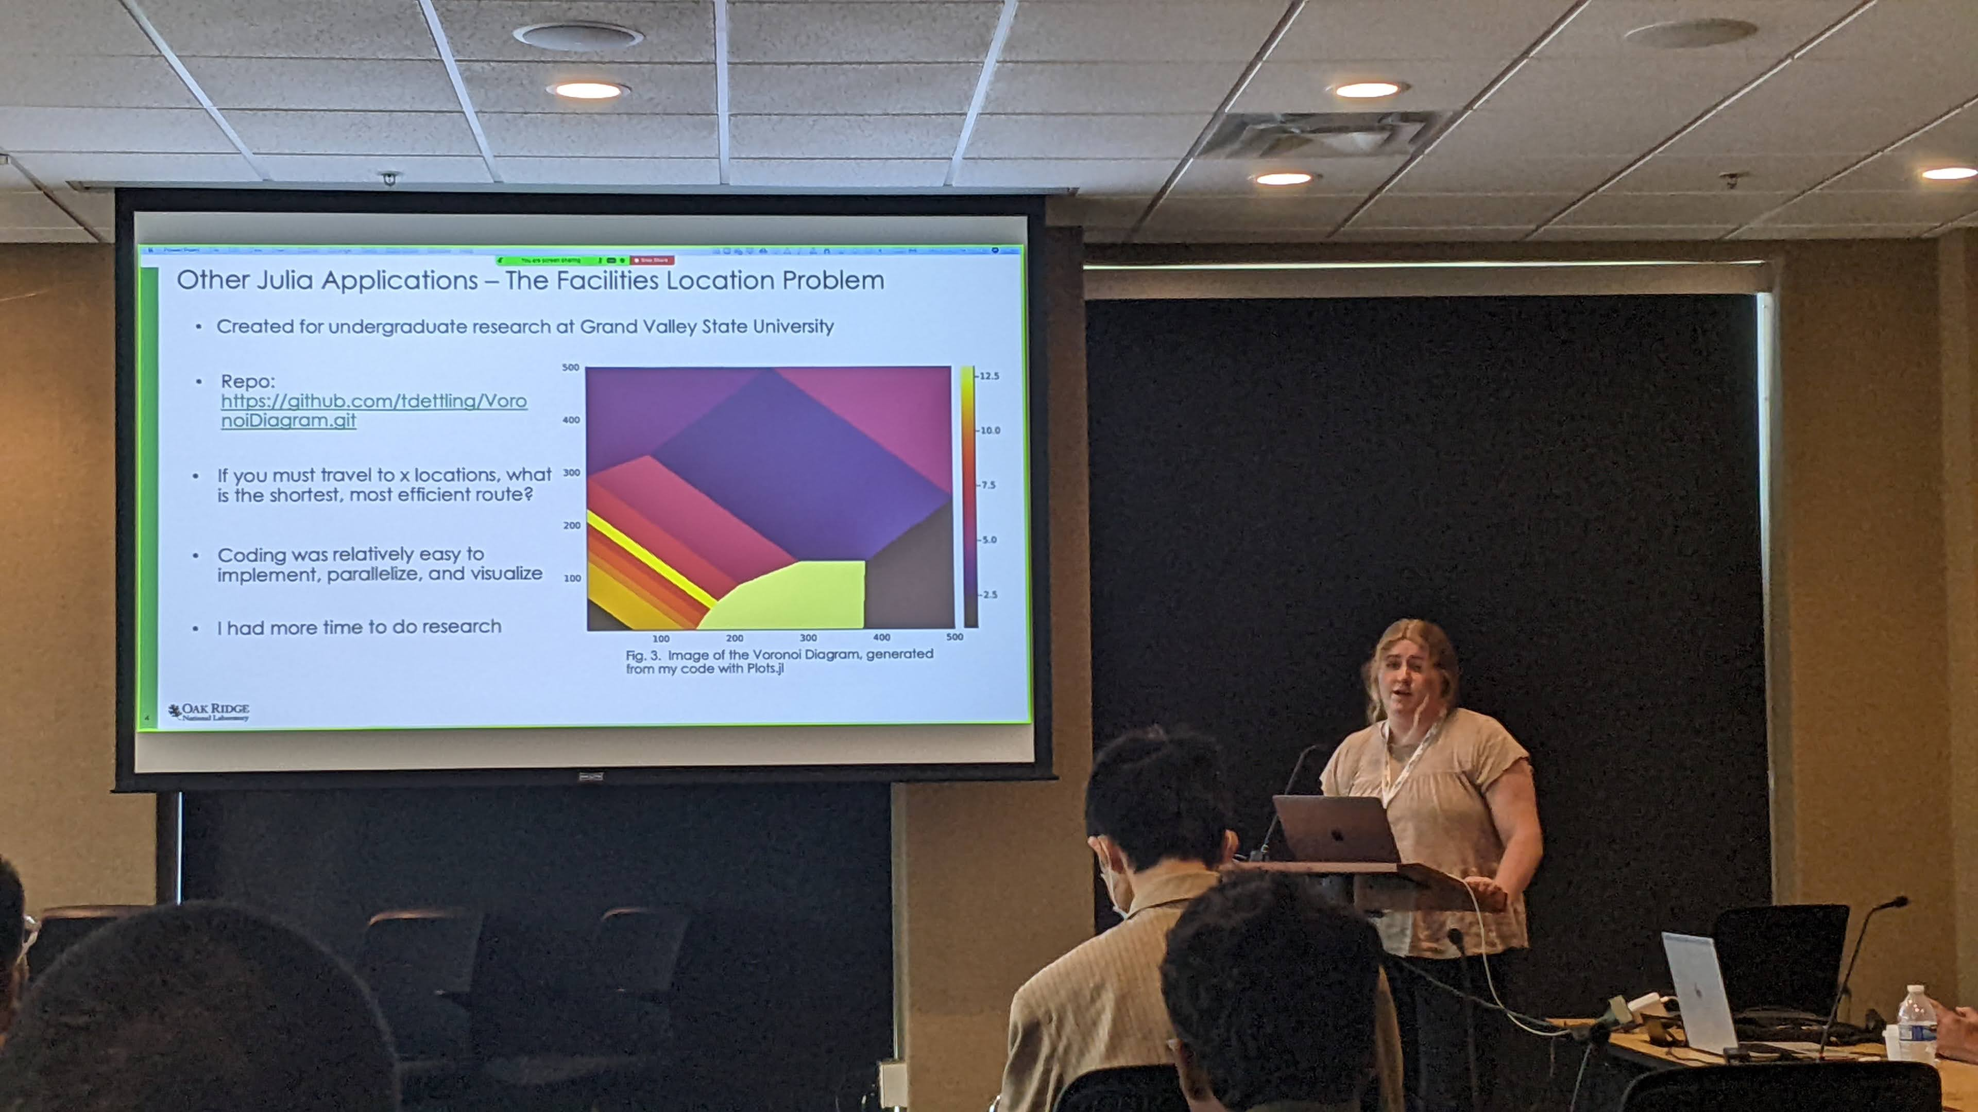

Welcome
First event in 2022: 101 registrations, 60 in-person, 51 virtual
1 morning tutorial, working lunch,12 lightning talks
2022: COVID, ECP…Frontier? LLM? ChatGPT? AI? NVIDIA?

Slide 4

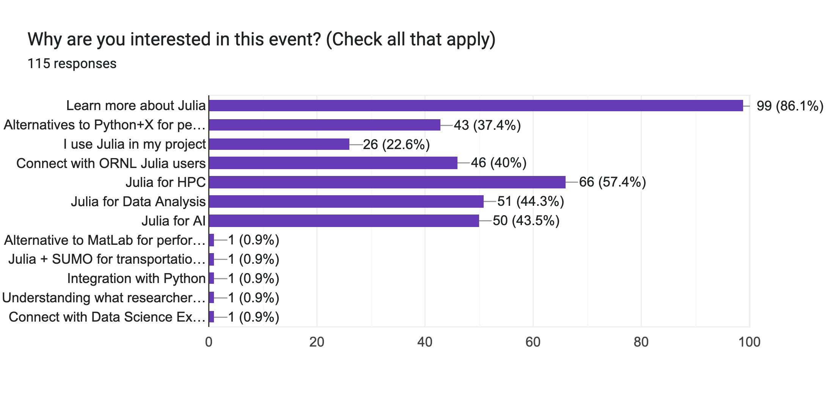
Welcome
Today’s workshop: 115 registrations, 75 in-person, 40 virtual, 15 talks
Event Website: https://ornl.github.io/events/jufos2024/
Goals:
Build community (learn, meet people, share your work)
Opportunities for ORNL science

Slide 5
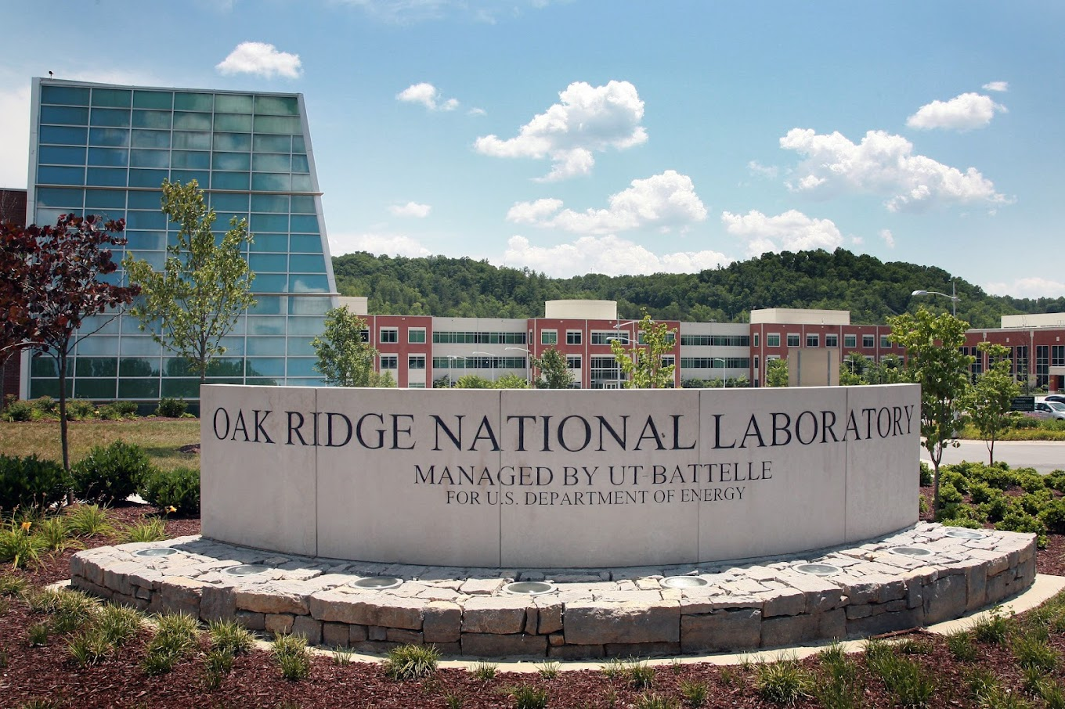

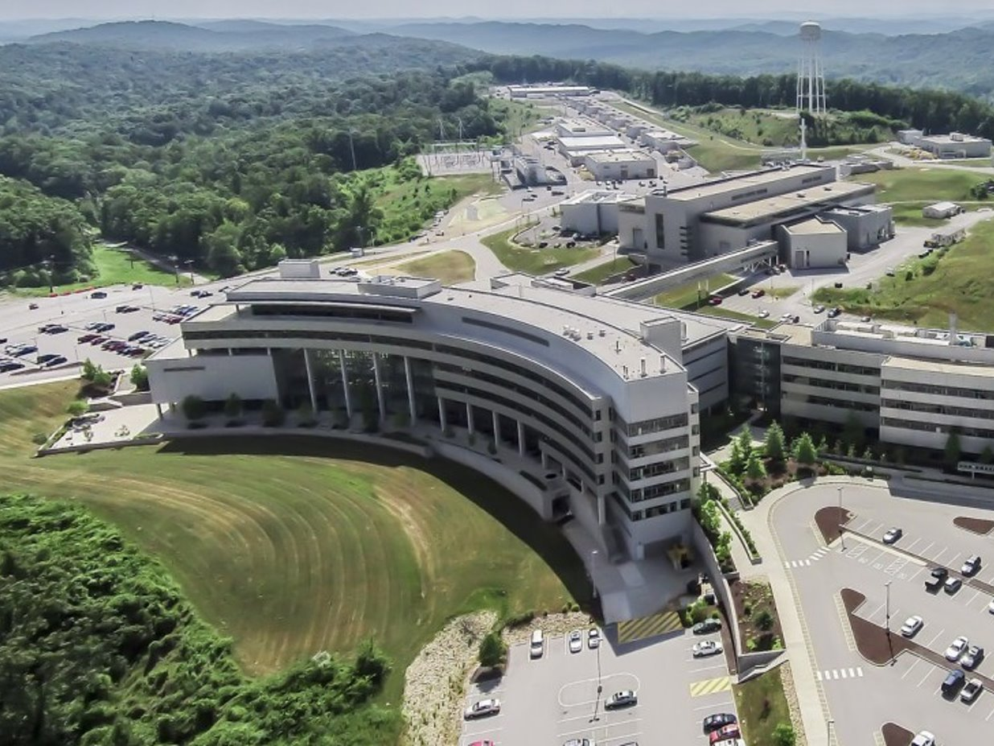
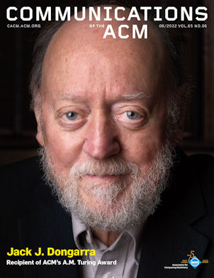
Oak Ridge National Laboratory
Funding by DOE mission
FY22: $2.4B
US Department of Energy Office of Science Lab
Budget $2.4 billion
5,800 staff
More than 100 disciplines
3,200 facility users and visiting scientists
User facilities
Oak Ridge Leadership Computing (OLCF)
Building Technologies Research and Integration Center (BTRIC)
Carbon Fiber Technology Facility (CFTF)
Center for Nanophase Materials Sciences (CNMS)
Center for Structural Molecular Biology (CSMB)
High Flux Isotope Reactor (HFIR)
Manufacturing Demonstration Facility (MDF)
National Transportation Research Center (NTRC)
Spallation Neutron Source (SNS)
Top500#1
Great place for a scientific career!
Notes:
DHS = Department of Homeland Security
EERE = DOE Office of Energy Efficiency and Renewable Energy
EM = DOE Office of Environmental Management
NE = DOE Office of Nuclear Energy
NNSA = National Nuclear Security Administration
WFO = Work for Others
ASCR = Advanced Scientific Research Computing
BES = Basic Energy Sciences
BER = Biological and Environmental Research
FES = Fusion Energy Sciences
HEP = High Energy Physics
NP = Nuclear Physics

Slide 6
Welcome: Schedule
Time | Session | Presenter
Morning
10:00am-10:30am | Welcome, updates, brief intro to Julia | William Godoy
10:30am-11:00am | LLMs and easy performance portability with JACC.jl in Julia | Pedro Valero-Lara
11:00am-11:45am | Invited Talk: “Sunny.jl: lessons learned from a DOE scientific application” | Kipton Barros, LANL
11:45am-12:10pm | Break
Working Lunch
12:10pm-12:50pm | Invited Talk: “Heterogeneous computing with the Julia language: from A64FX to the IPU” | Mosè Giordano, UCL/ARC, UK
12:50pm-1:00pm | Break
Afternoon
1:00pm-2:00pm | Lightning Talks/Panel Session 1: Methods and Infrastructure | Session Chair: Het Mankad
 | JuliaIRIS: Julia with IRIS Heterogeneous Runtime System | Narasinga Rao Miniskar
 | Performance Portability with Julia: My Internship Experience | Claire Winogrodzki
 | Julia Implementation of a Fast Heuristic Solver for Binary Optimization | Ryan Bennink
 | Evaluation of the convolution operator in a Julia machine learning library | Zheming Jin
 | Novel iterative methods for multiphysics problems | Nicolás Barnafi
 | Pkg - Julia’s Integrated User-Friendly Package Manager | Kelly Tang
 | The Experimental Computing Laboratory (ExCL) | Steven Moulton
 | Panel Discussion
2:00pm-2:15pm | Break
2:15pm-3:45pm | Lightning Talks/Panel Session 2: Applications | Session Chair: Het Mankad
 | Expanding Mathematical Sets into Programming: An Introduction to Julia’s SetBuilders | Youngsung Kim
 | Integrating high-throughput ODEs and Molecular Language Models in Julia and Pytorch | Zachary Fox
 | Node-level regression task to predict vaccine hesitancy from graph learning | Sifat Afroj Moon
 | Remotely-sensed change detection with Julia | David Hughes
 | AutoCSM - Automating Supercomputer Cooling System Model Generation | Scott Greenwood
 | Must.jl Multiple Scattering Theory for First Principles Calculations of Materials | Markus Eisenbach
 | Julia for HPC- Porting to AMD GPU devices for Climate Applications | Antigoni Georgiadou
 | Integrating Julia and OLCF HPC infrastructure to enhance SNS data processing capabilities | Steven E. Hahn
 | Panel Discussion
3:45pm-4:00pm | Closing remarks, adjourn | Pedro Valero-Lara, William Godoy

Slide 7
Contents
Welcome
Julia’s value proposition for science: LLVM + Coordinated Ecosystem
Update: Efforts in HPC
Resources: where to get started?
Acknowledgments

Slide 8



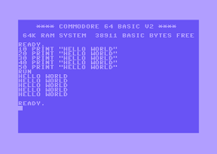





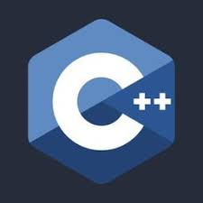
























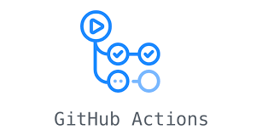

Yet another language?
80-90s
BSc 2002
PhD 2009
Intel 2012
ORNL 2016
Today
Things I use today weren't always there

Slide 9






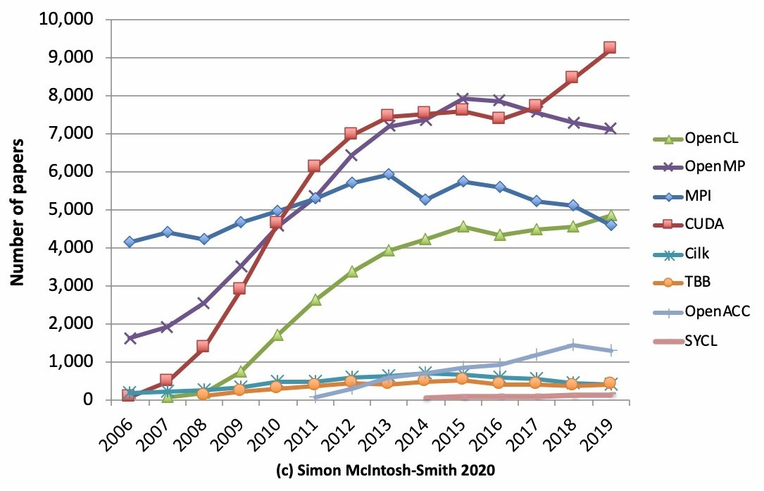
Landscape of computing: The Tower of Babel
Scientific software:
Performance languages: C, C++, Fortran
High-level productivity languages: Python, Matlab, R
Plethora of programming models for heterogeneous computing . Standard, vendor-specific, third party
Major shift: vendor compiler convergence around LLVM
Slowdown in Moore's Law cadence puts more focus on massively parallel, vectorized computing: ARM, NVIDIA/AMD GPU, Intel’s Xeon, KNL, Sapphire Rapids, AVX-512
AI/ML + traditional HPC requires powerful reproducible programming abstractions for computation, communication and data
Choosing a programming model is not always a technical decision
https://www.nextplatform.com/2020/04/28/programming-in-the-parallel-universe/

Slide 10
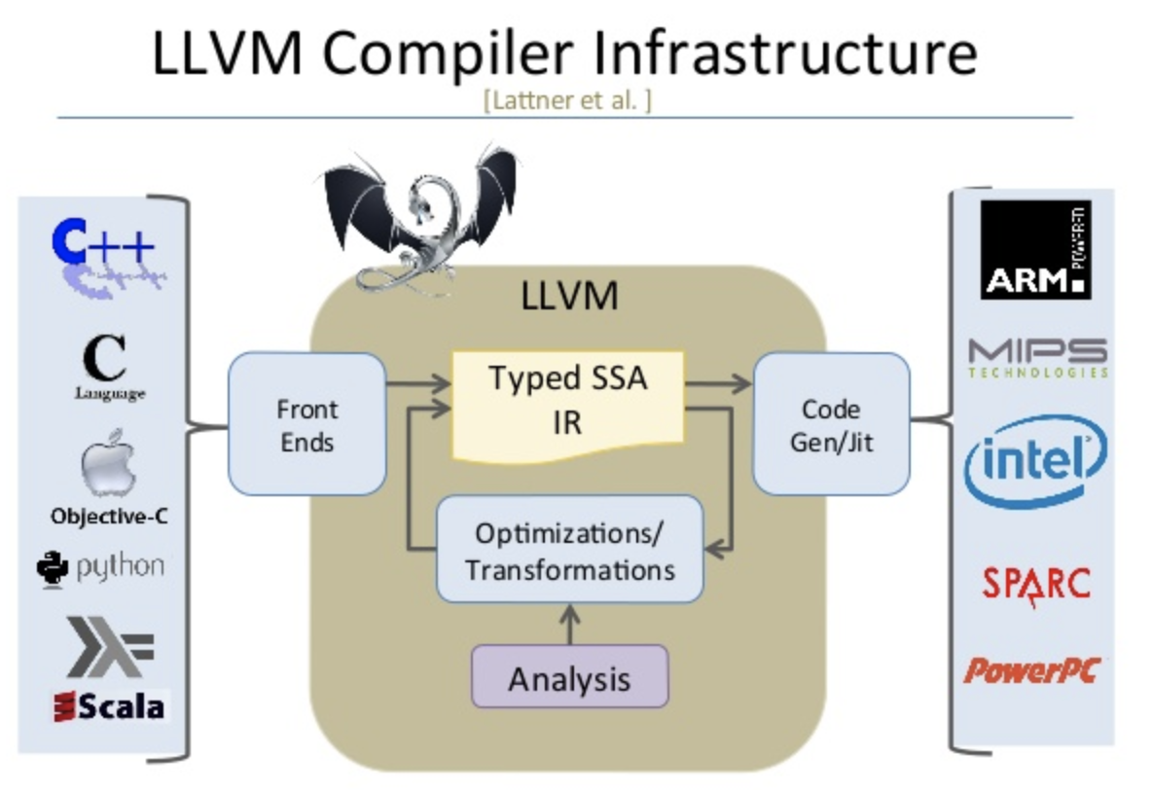
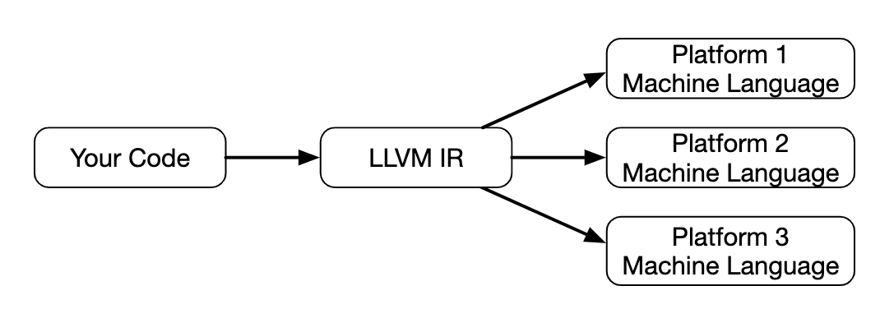
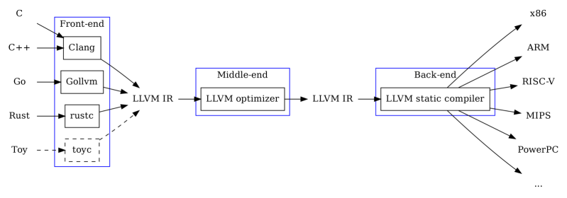
LLVM: a game changer
https://llvm.org/
C. Lattner and V. Adve, "LLVM: a compilation framework for lifelong program analysis & transformation," International Symposium on Code Generation and Optimization, 2004. CGO 2004., 2004, pp. 75-86, https://doi.org/10.1109/CGO.2004.1281665 .
http://www.aosabook.org/en/llvm.html
LLVM Typed Static Single Assignment (SSA) Intermediate Representation (IR) aka LLVM-IR: https://patshaughnessy.net/2022/2/19/llvm-ir-the-esperanto-of-computer-languages
%57 = call %"Array(Int32)"* @"*Array(Int32)@Array(T)::unsafe_build:Array(Int32)"(i32 610, i32 2), !dbg !89

Slide 11

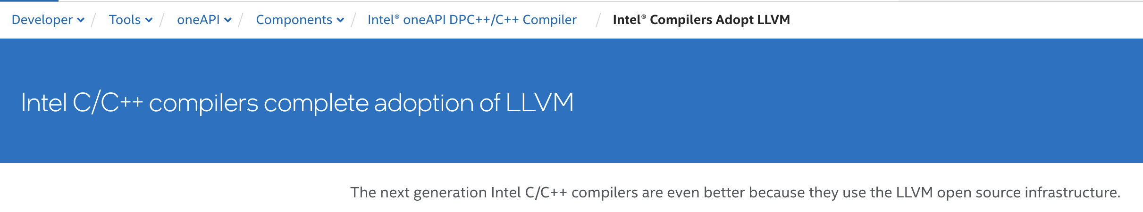
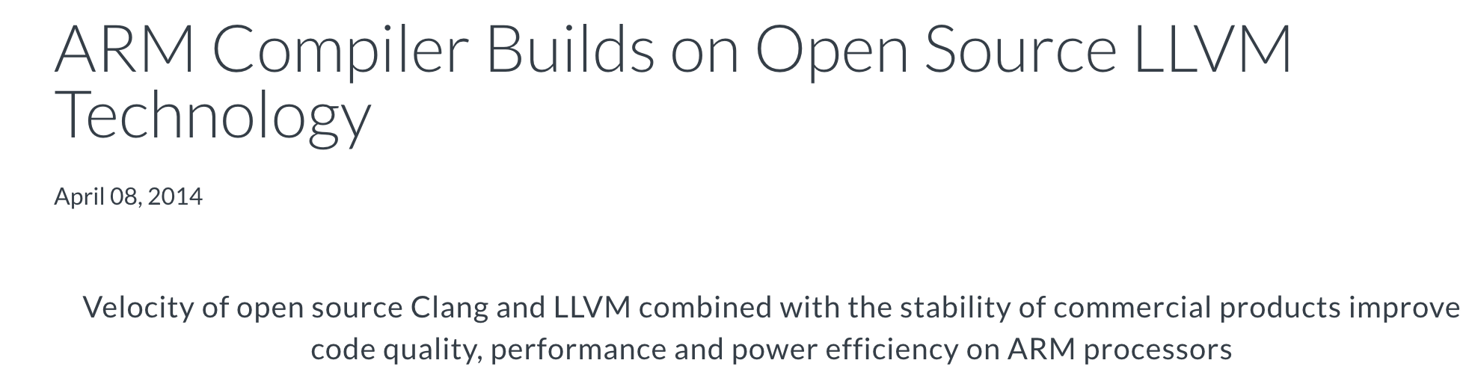

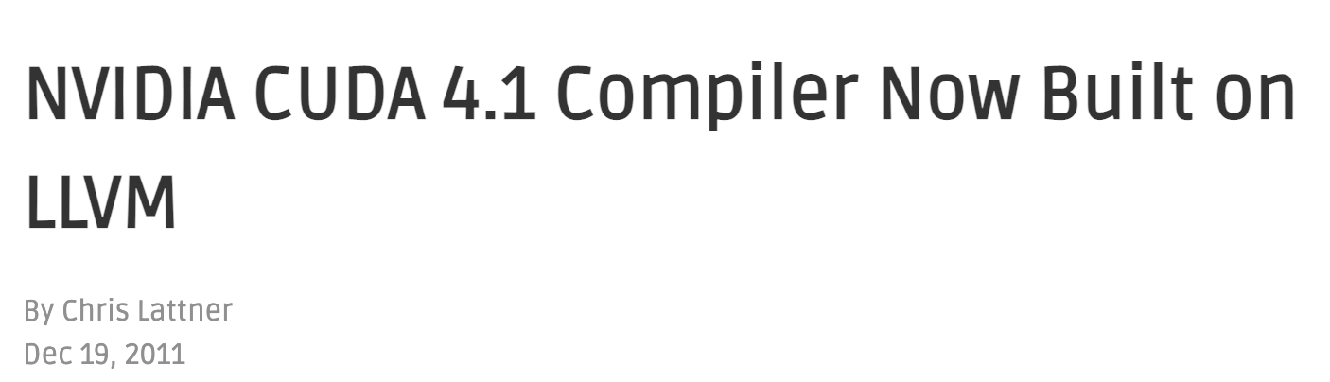
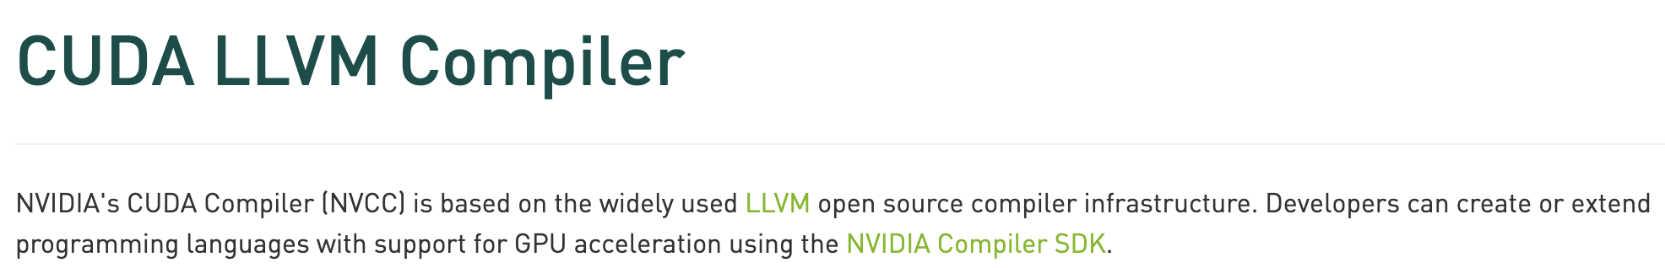
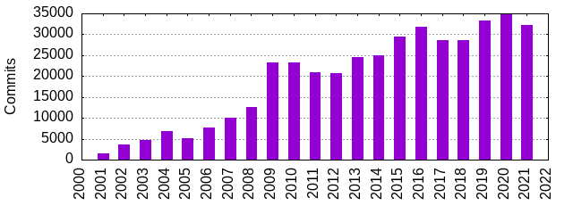
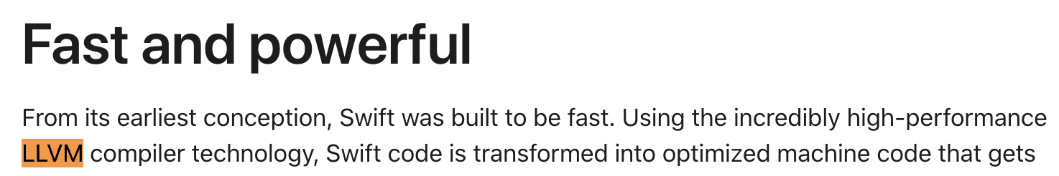
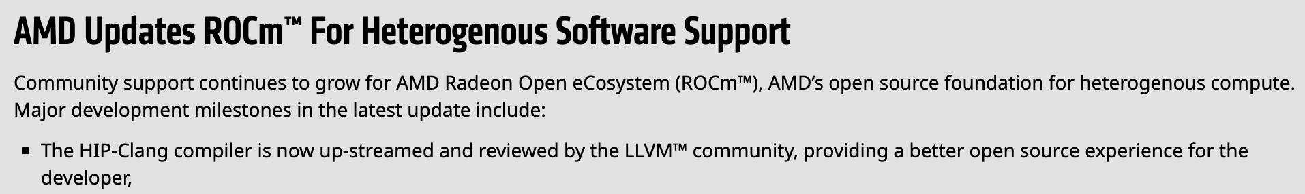
LLVM: Vendor and programming model adoption
Intel
https://www.ornl.gov/project/proteas-tune
ARM
https://csmd.ornl.gov/project/clacc
https://openmp.llvm.org
NVIDIA
LLVM Commits
Apple
AMD

Slide 12
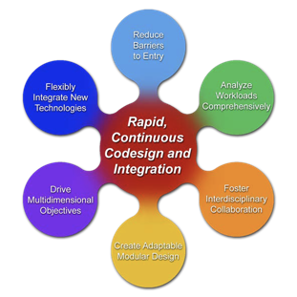
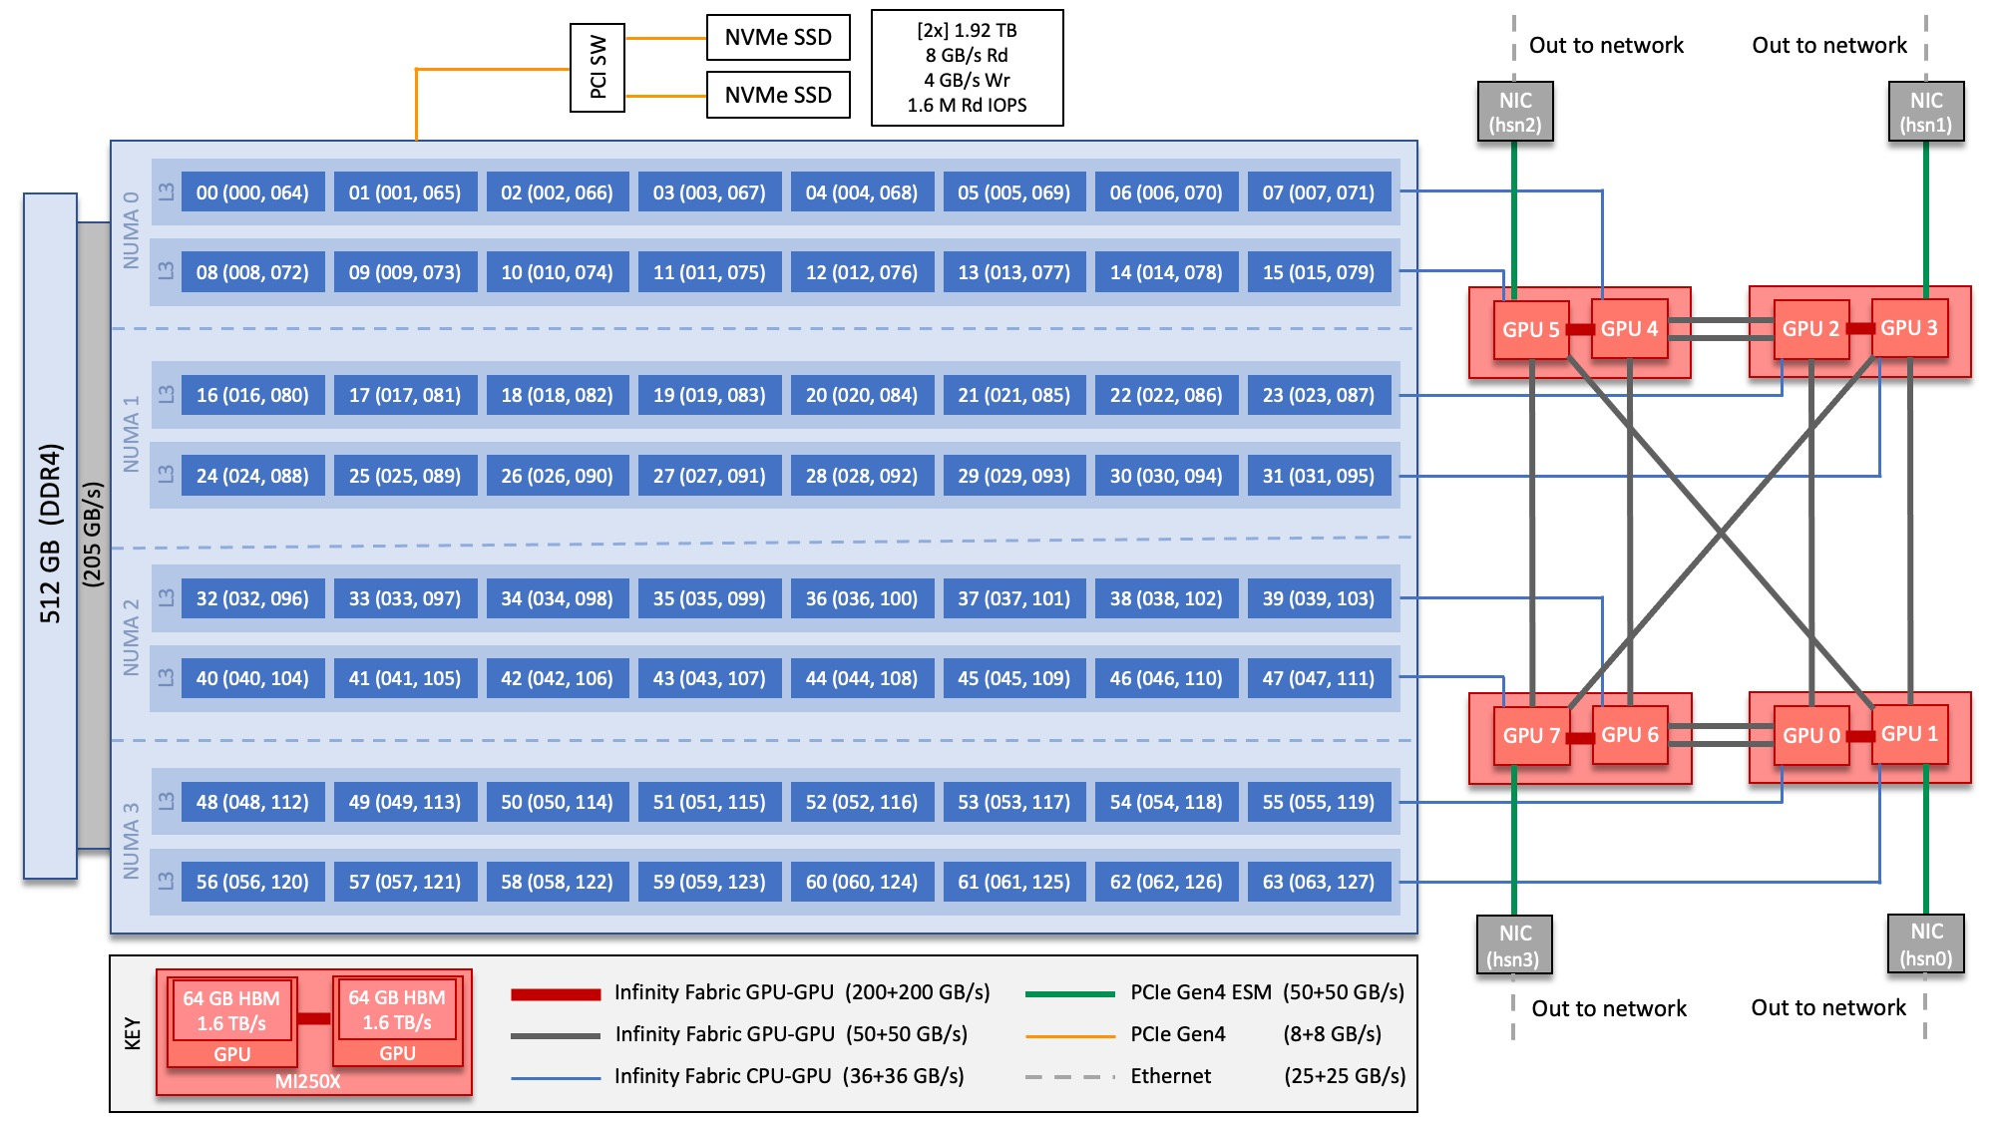
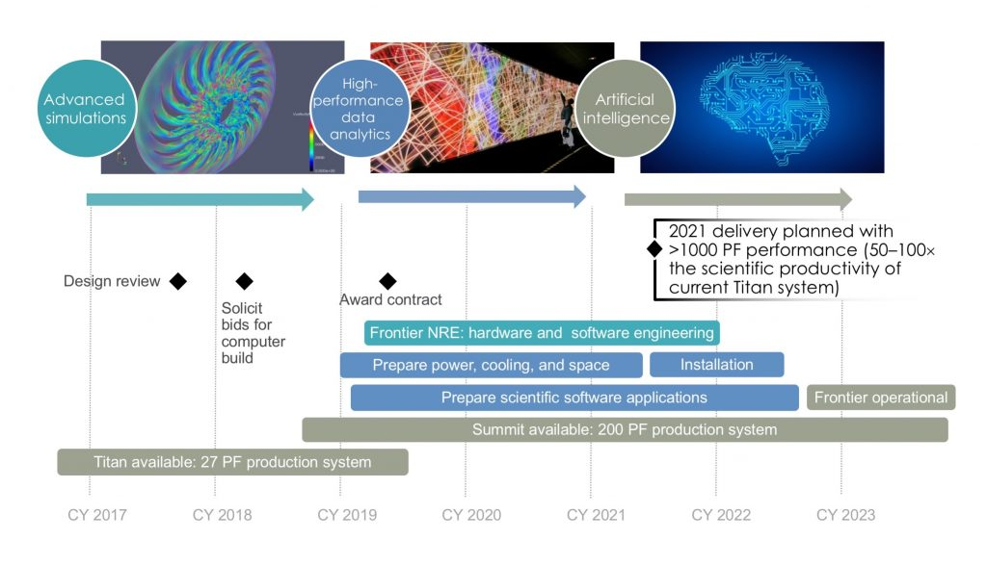
Rethink how we do Computing
Scientific programming is HARD (specially on our Leadership Computing Facilities, LCFs)
Software is our “specialized science equipment” for science
There is still a lot of plumbing to be done
“Can a machine translate a sufficiently rich mathematical language into a sufficiently economical program at a sufficiently low cost to make the whole affair feasible?”--------------------------- Backus on Fortran (1980)
Programming productivity is always a challenge
Barrier to entry from idea to portable performance
AI/ML+HPC is a multidisciplinary co-design challenge
How to leverage ECP legacy?
Key question: “What novel approaches to software design and implementation can be developed to provide performance portability for applications across radically diverse computing architectures?” from Reimagining Codesign for Advanced Scientific Computing: Unlocking Transformational Opportunities for Future Computing Systems for Science. DOE Report https://doi.org/10.2172/1822198

Slide 13
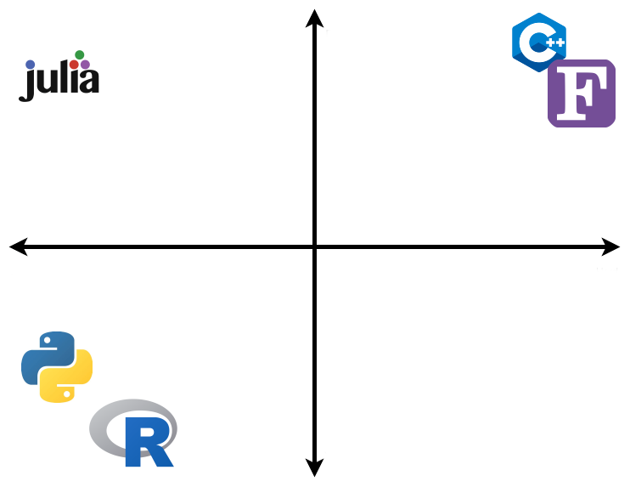

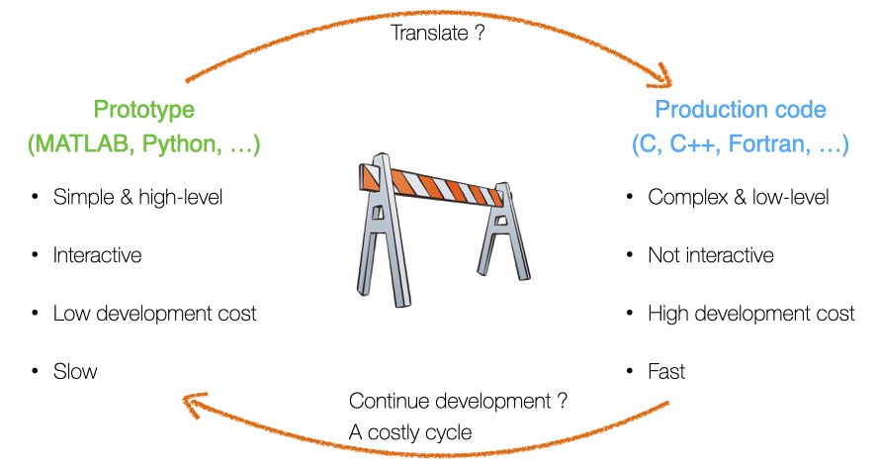
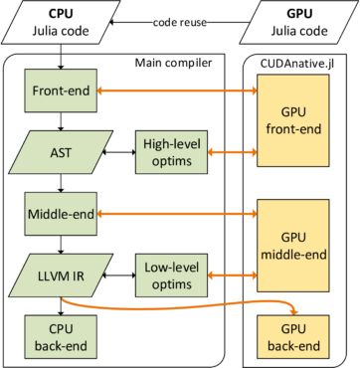
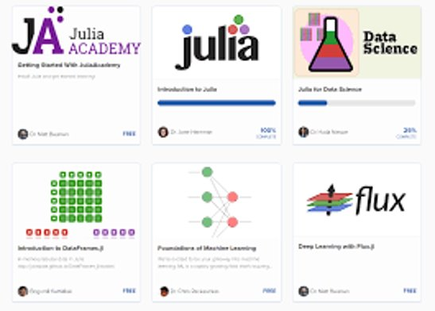

Julia's value proposition for science
Designed for “scientific computing” (Fortran-like) and “data science” (Python-like) with performant kernel code via LLVM compilation
Lightweight interoperability with existing Fortran and C libraries
Julia is a unifying workflow language with a coordinated ecosystem
Fast
Easy
Hard
“Julia does not replace Python, but the costly workflow process around Fortran+Python+X, C+X, Python+X or Fortran+X (e.g. GPUs, simulation + data analysis)”
where X = { conda, pip, pybind11, cython, Python, C, Fortran, C++, OpenMP, OpenACC, CUDA, HIP, CMake, numpy, scipy, matplotlib, Jupyter, …}
Slow
https://juliadatascience.io/
Rich data science
ecosystem
LLVM
Pkg.jl
https://pde-on-gpu.vaw.ethz.ch/lecture7
https://developer.nvidia.com/blog/gpu-computing-julia-programming-language/
https://quantumzeitgeist.com/learning-the-julia-programming-language-for-free/

Slide 14



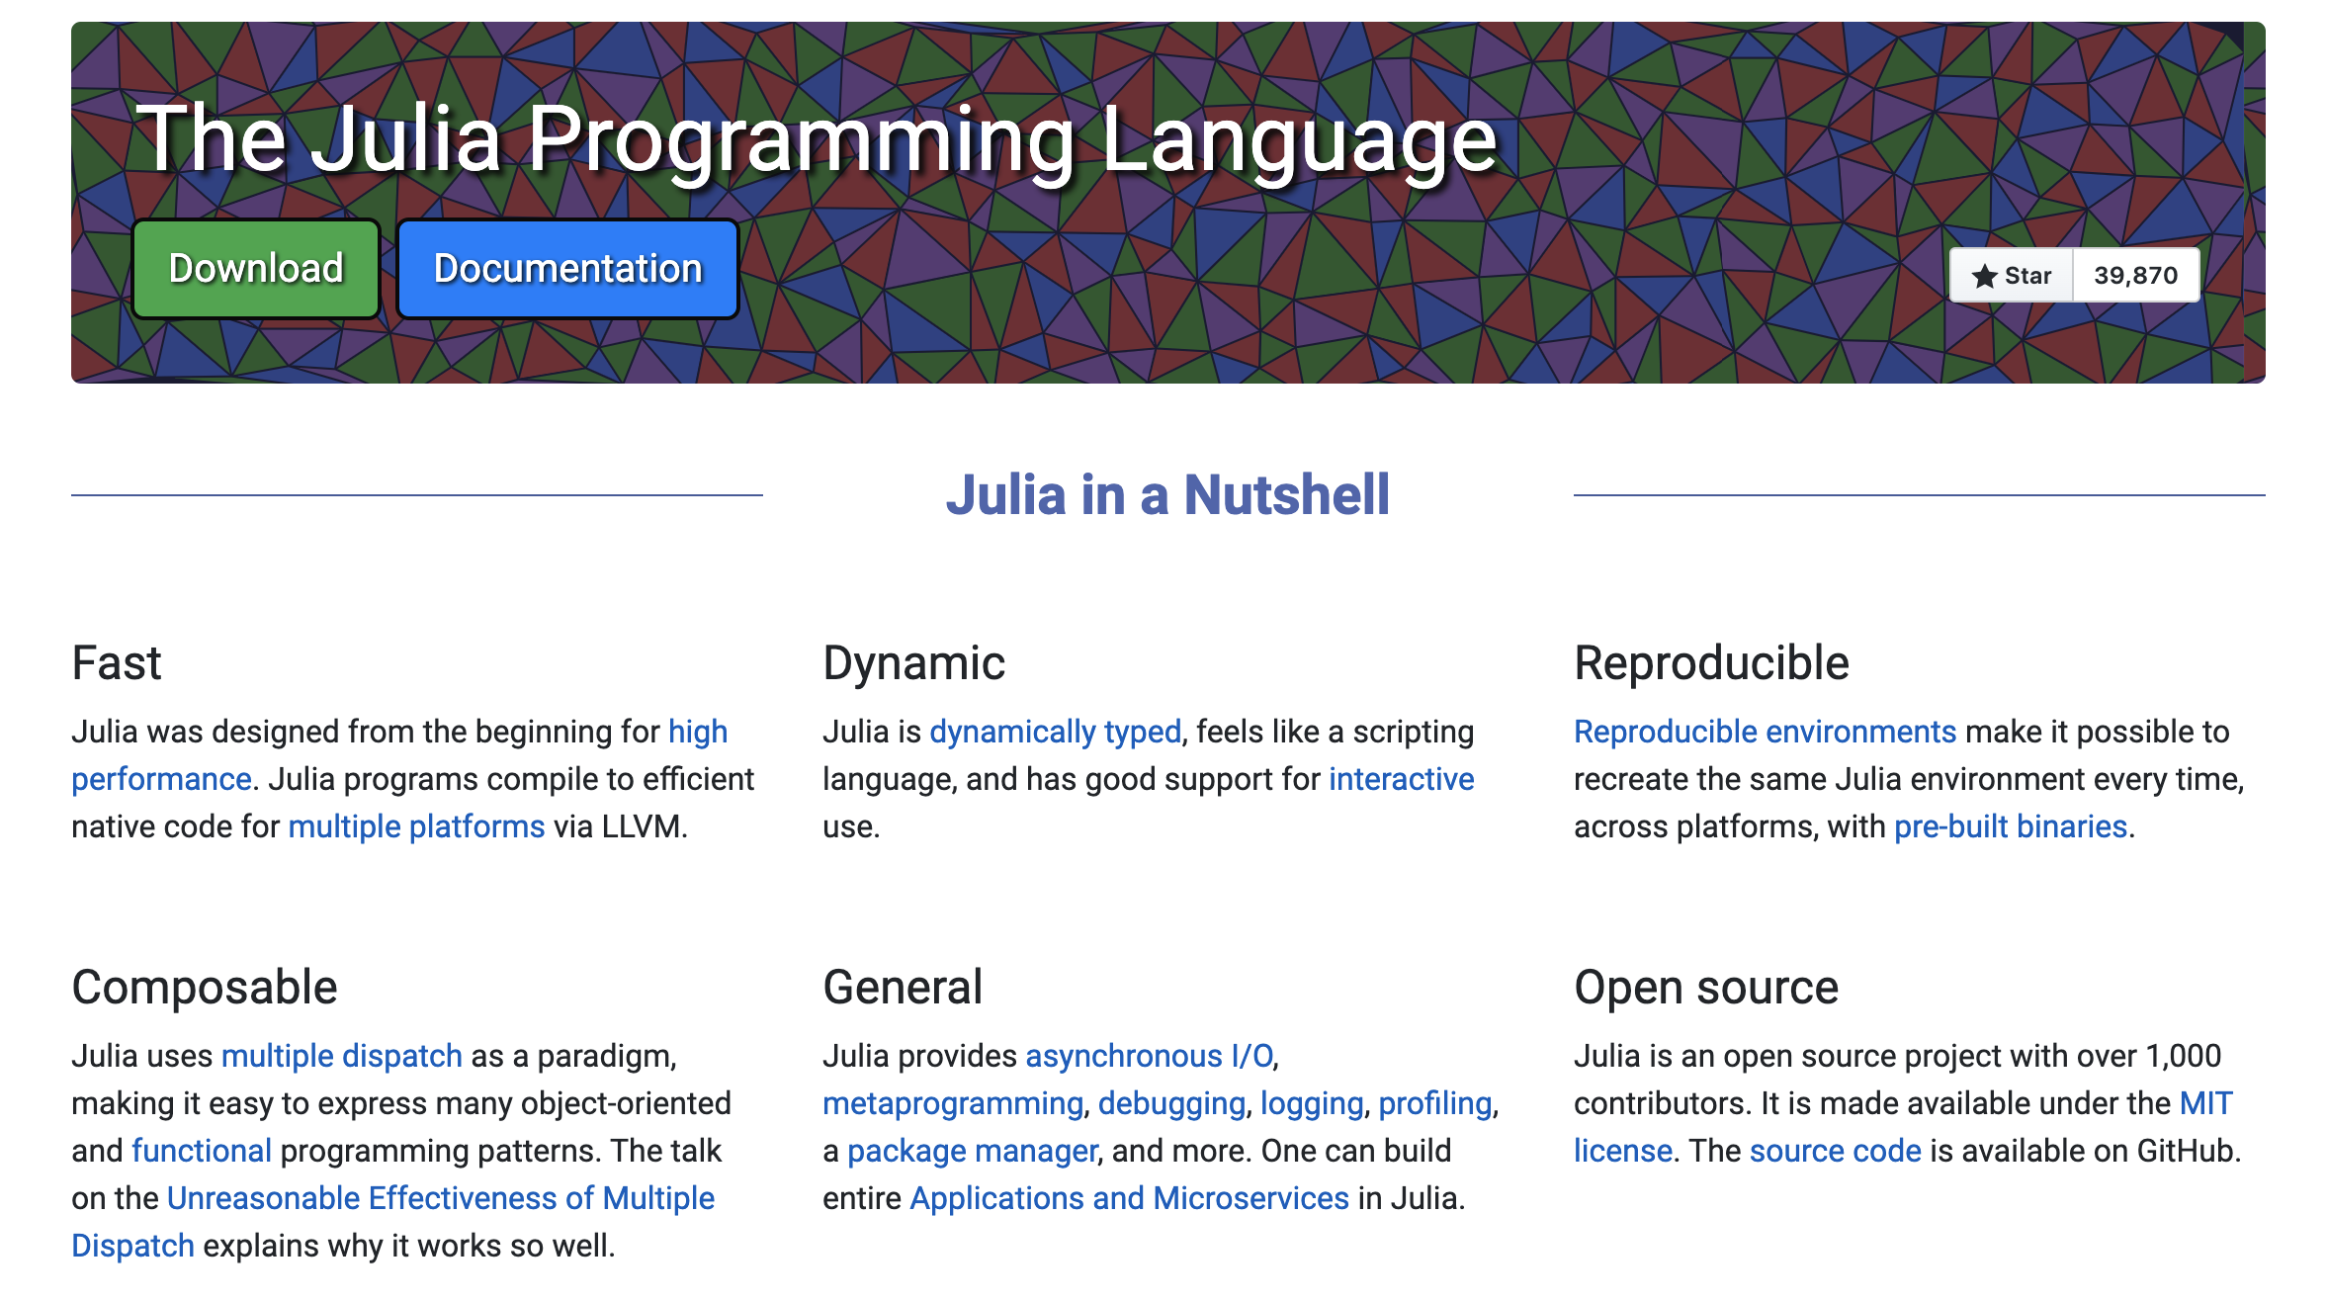
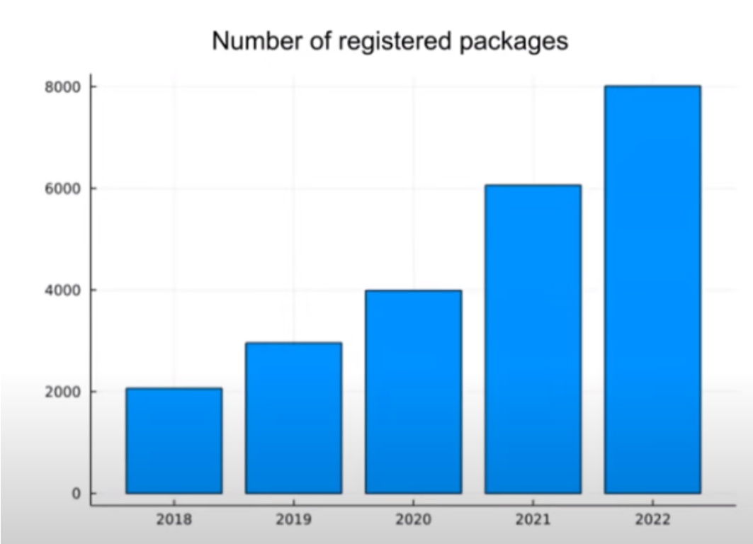
Julia Brief Walkthrough
History: started at MIT in the early 2010s (predates Python Numba) https://julialang.org/blog/2022/02/10years/
JuliaHub (formely Julia Computing) and MIT are major contributors: https://juliacomputing.com/case-studies
First stable release v1.0 in 2018, v1.10 as of 2024 https://julialang.org/
Open-source GitHub-hosted packages and ecosystem with MIT permissive license: https://github.com/JuliaLang/julia
Community: annual JuliaCon summer conference: https://juliacon.org/2024/
95% of Julia packages in the registry had some form of CI (youtube.com/watch?v=9YWwiFbaRx8)

Slide 15
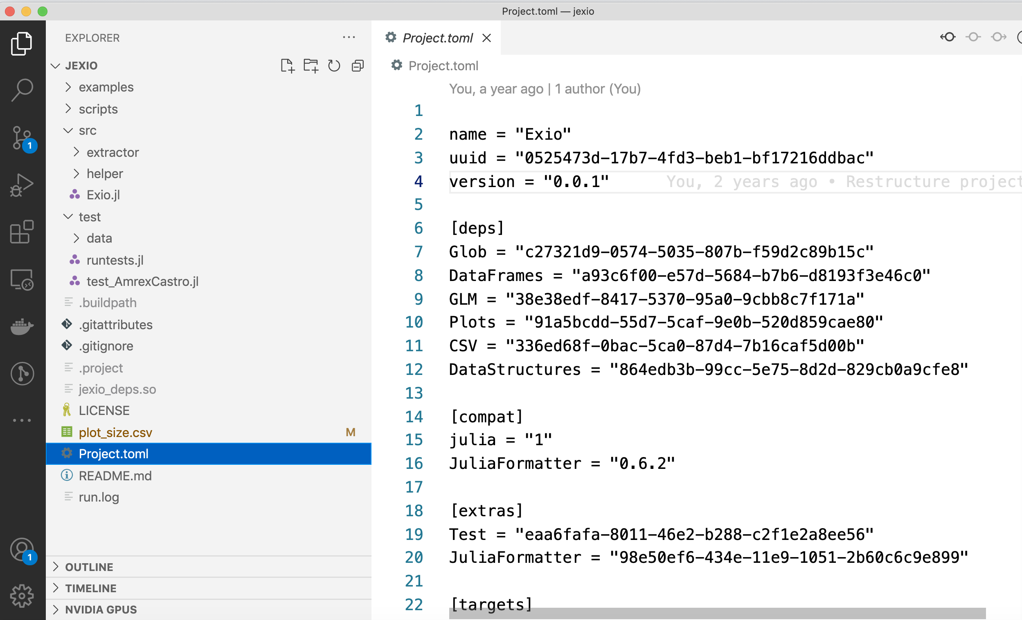
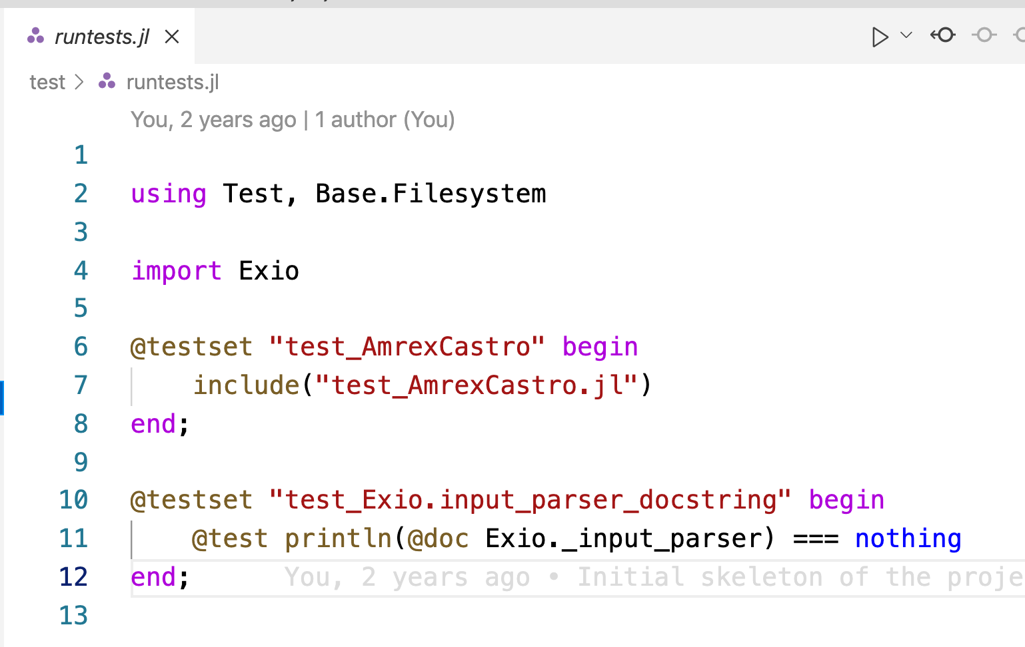
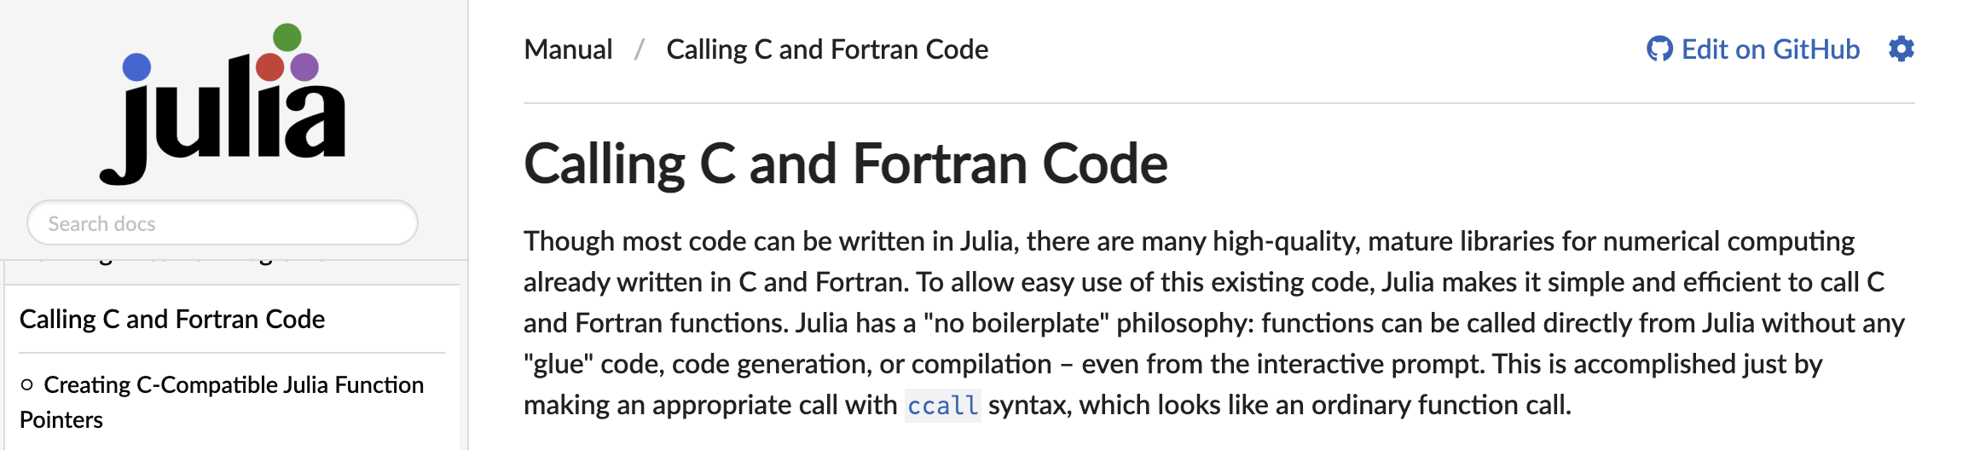
Julia Brief Walkthrough
Reproducibility is in the core of the language:
- Interactive: Jupyter, Pluto.jl
- Packaging Pkg.jl
- Environment Project.toml
- Testing Test.jl
Just-in-time or Ahead-of-time compilation with PackageCompiler.jl
Powerful metaprogramming for code instrumentation: @profile, @time, @testset, @test, @code_llvm, @code_native, @inbounds,
Interoperability is key: @ccall, @cxx, PyCall, CxxWrap.jl
https://github.com/ornl-training/julia-basics
Notes:
To the terminal

Slide 16
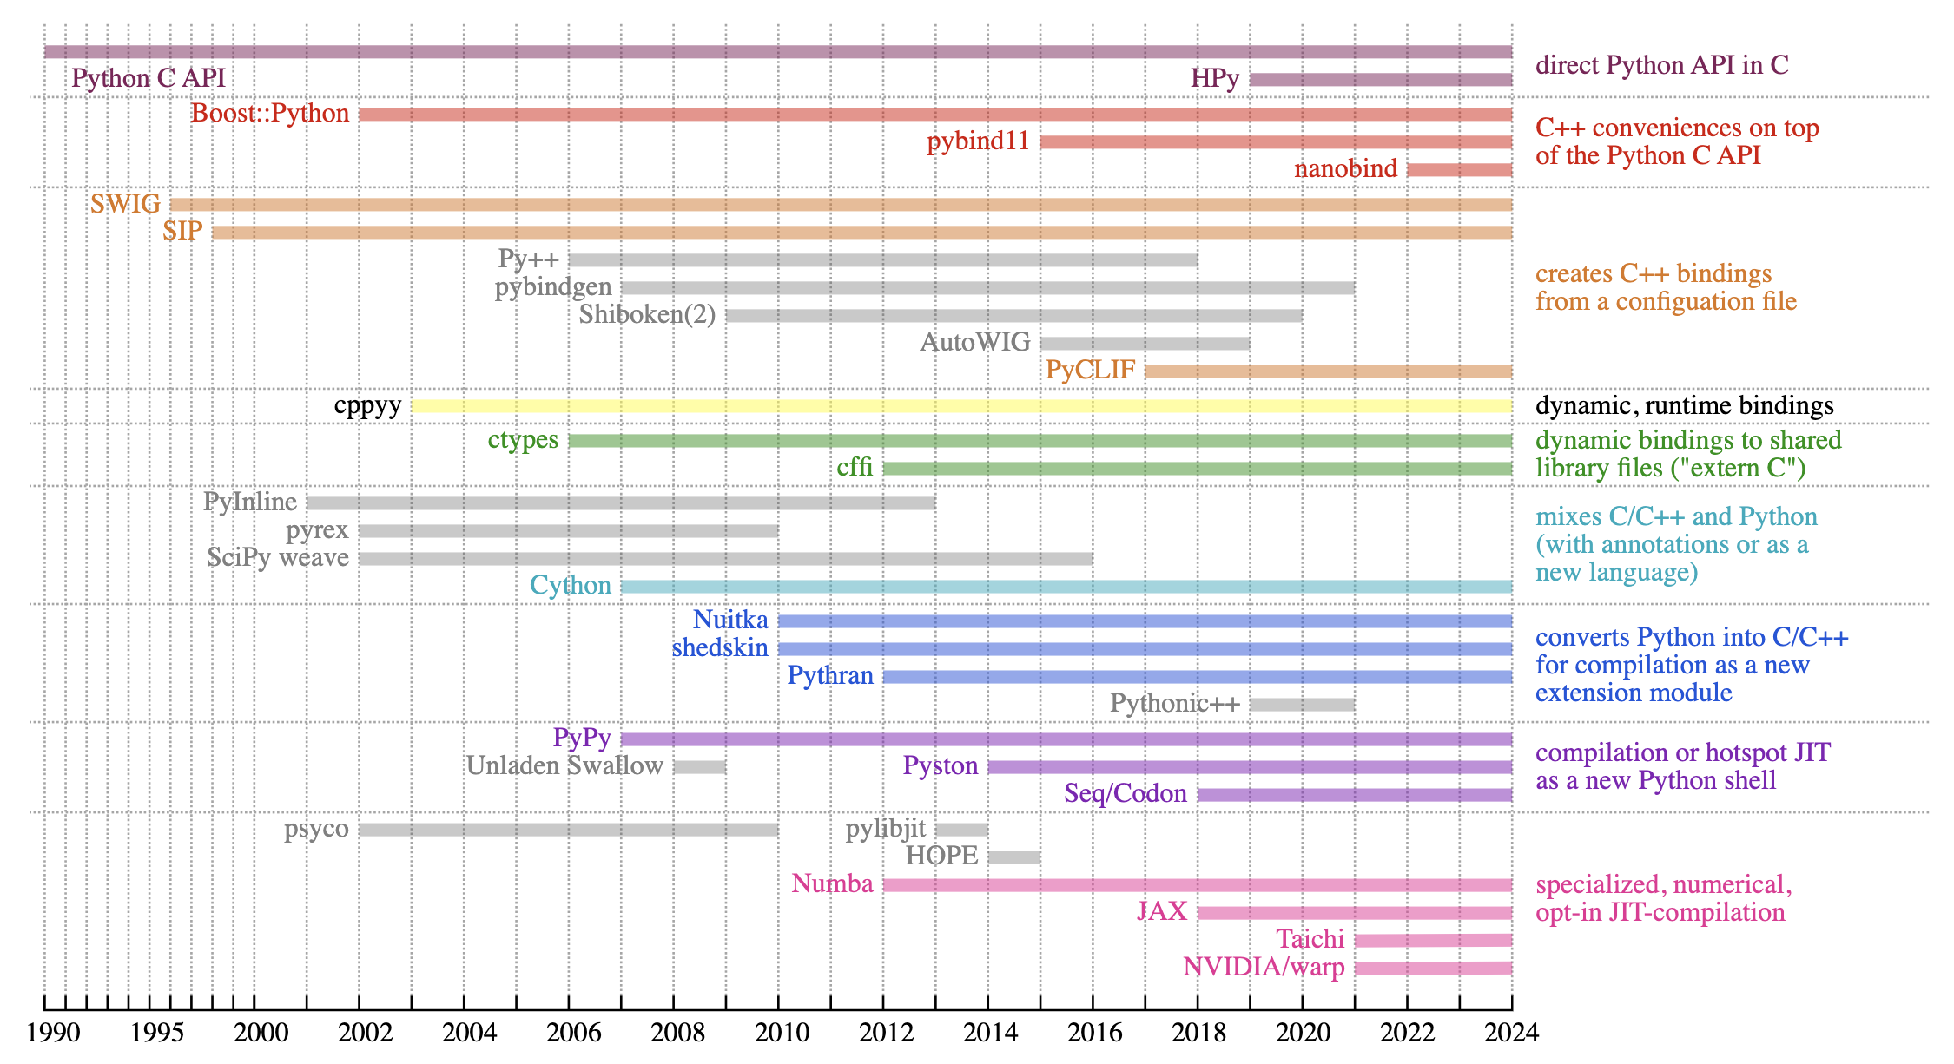
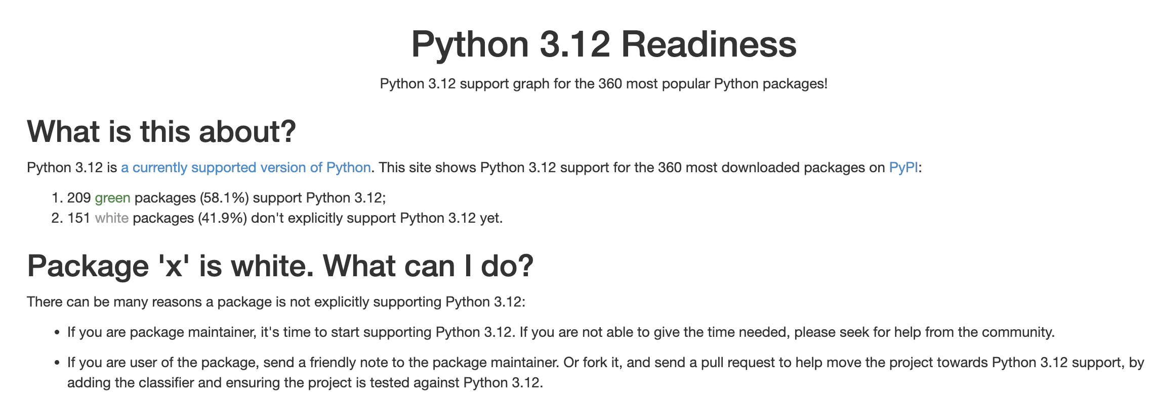
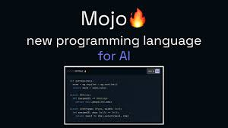
Python is not enough…and is a fragmented world
Make Python faster
https://pyreadiness.org/3.12/
https://raw.githubusercontent.com/jpivarski-talks/2023-05-01-hsf-india-tutorial/main/img/history-of-bindings-2.svg

Slide 17
Contents
Welcome
Julia’s value proposition for science: LLVM + Coordinated Ecosystem
Update: Efforts in HPC
Resources: where to get started?
Acknowledgments

Slide 18
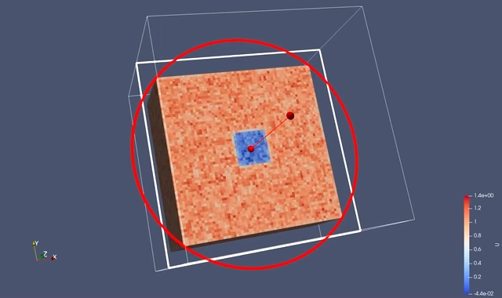
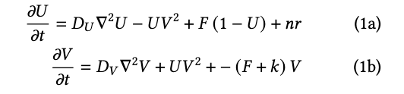
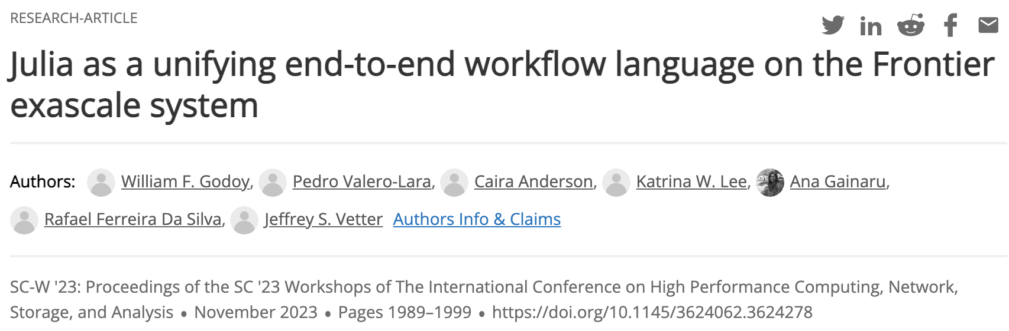

Gray-Scott miniapp: https://github.com/JuliaORNL/GrayScott.jl
Simple 3D 2-variable diffusion-reaction solver
CPU Threads, CUDA.jl and AMDGPU.jl backends using multiple dispatch
Parallel I/O ADIOS2, can be visualized with ParaView
MPI.jl for communication
Configuration and job scripts for Frontier, Crusher and Summit under ./scripts/
Data analysis on JupyterHub
Best paper at SC23 WORKS
Research question: Can I write an entire HPC workflow in Julia?
https://doi.org/10.1145/3624062.3624278
https://www.nextplatform.com/2023/09/26/julia-still-not-grown-up-enough-to-ride-exascale-train/
Notes:
Vendor gaps

Slide 19
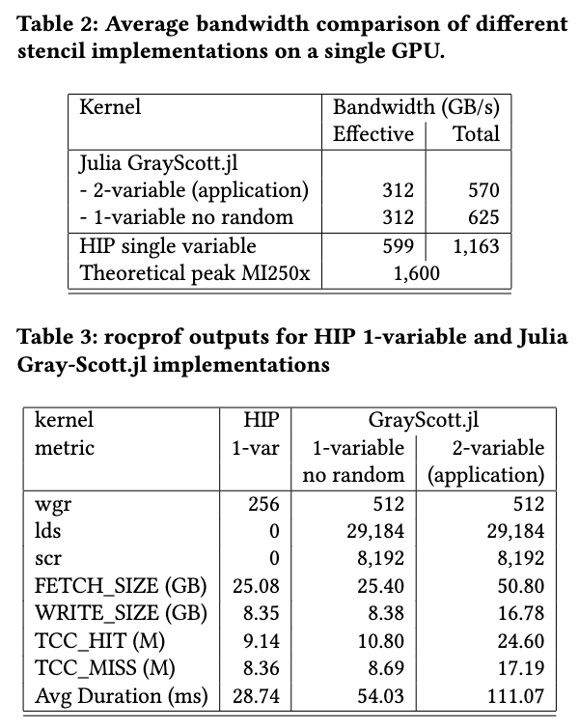
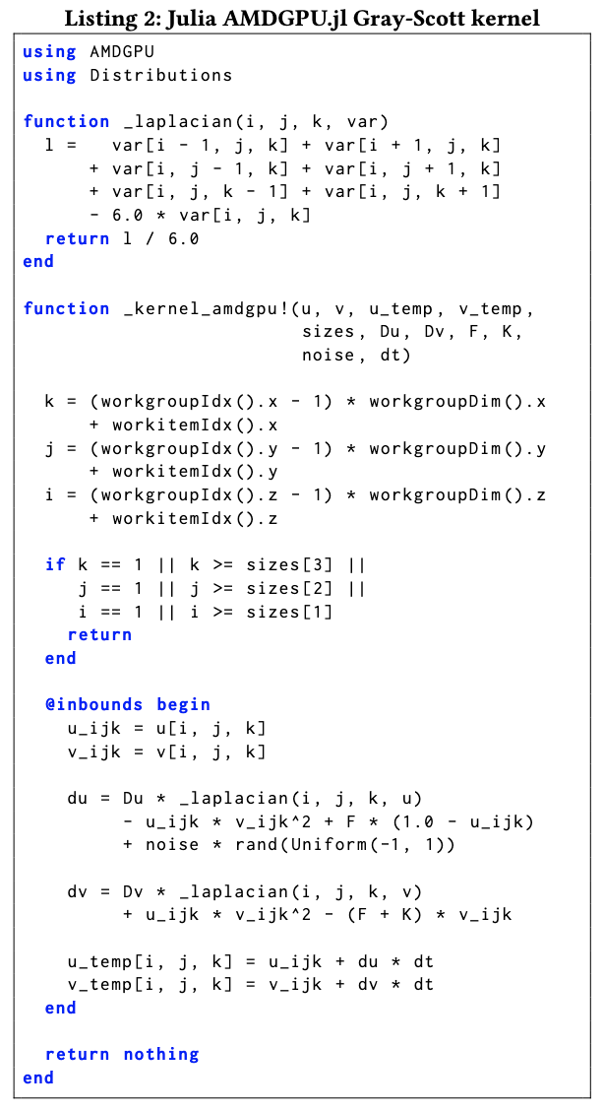
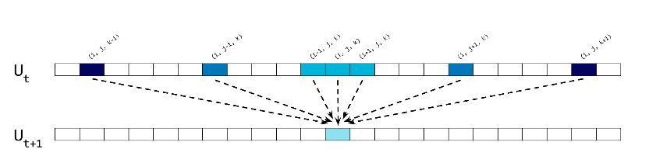
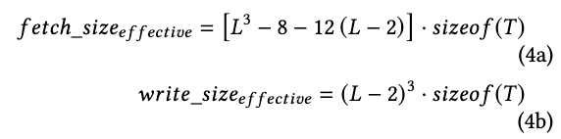
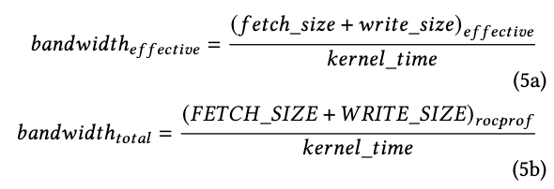
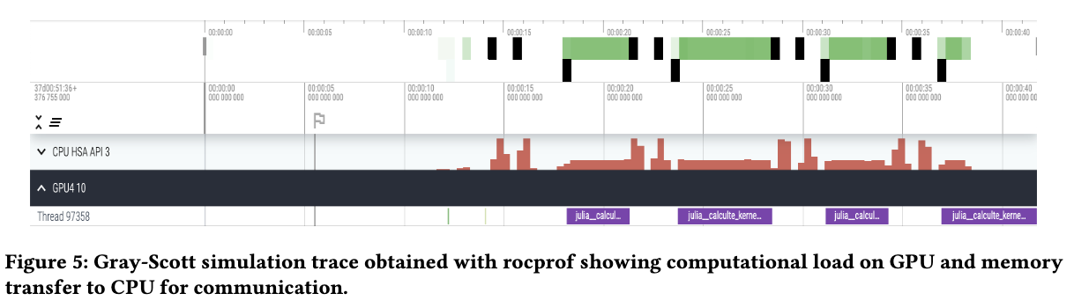
Frontier on-node scalability using AMDGPU.jl
7-point stencil
Notes:
Vendor gaps

Slide 20
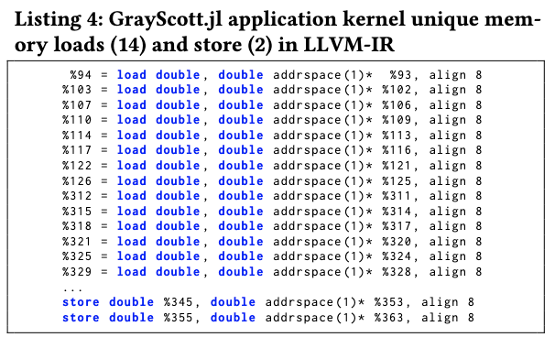
Frontier on-node scalability using AMDGPU.jl
7-point stencil
Julia AMDGPU.jl reaches ~50% bandwidth (performance) of HIP
No surprises on: FETCH/WRITE SIZE, LLVM-IR
rocprof reports more activity “lds” on Julia
Notes:
Vendor gaps

Slide 21
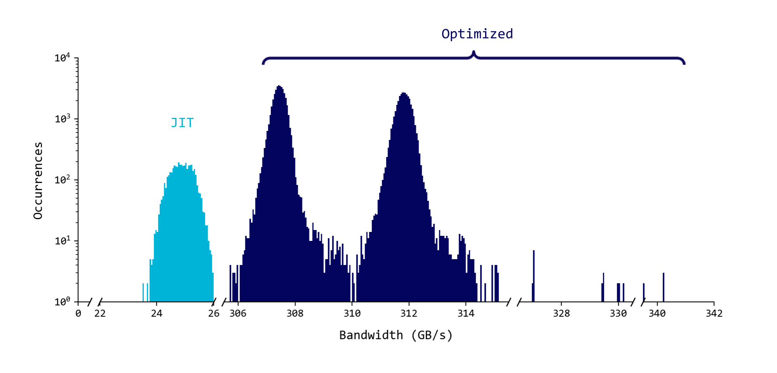
Frontier on-node scalability using AMDGPU.jl for several GPUs
Bandwidth distribution for 4,096 GCD (GPUs) and 20 timesteps. HIP ~ 600 GB/s (800 GB/s claimed on MI250x), Theoretical Peak on MI250x = 1,600 GB/s
Notes:
Vendor gaps

Slide 22
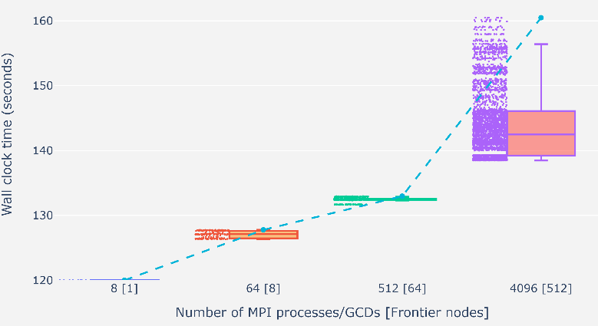
GrayScott.jl Weak Scaling on Frontier
Tested successfully up to 512 nodes (5% of Frontier) 1 GCD/MPI proc using MPI.jl
Tried 4K nodes (50% of Frontier) resulted in a libfabric error
2-3% variability up to 64 nodes
12-15% variability at 512 nodes
Notes:
Vendor gaps

Slide 23
GrayScott.jl Parallel I/O Weak Scaling on Frontier file system
We tested parallel I/O using Julia via the ADIOS2.jl Julia bindings
ADIOS2 is a high-performance data I/O library funded by the US Department of Energy SC ASCR
Results are shown for the Orion file system
ADIOS2.jl shows negligible overhead wrt ADIOS2
Godoy, W. F., Podhorszki, N., Wang, R., Atkins, C., Eisenhauer, G., Gu, J., ... & Klasky, S. (2020). Adios 2: The adaptable input output system. a framework for high-performance data management. SoftwareX, 12, 100561. https://doi.org/10.1016/j.softx.2020.100561
Notes:
Vendor gaps

Slide 24
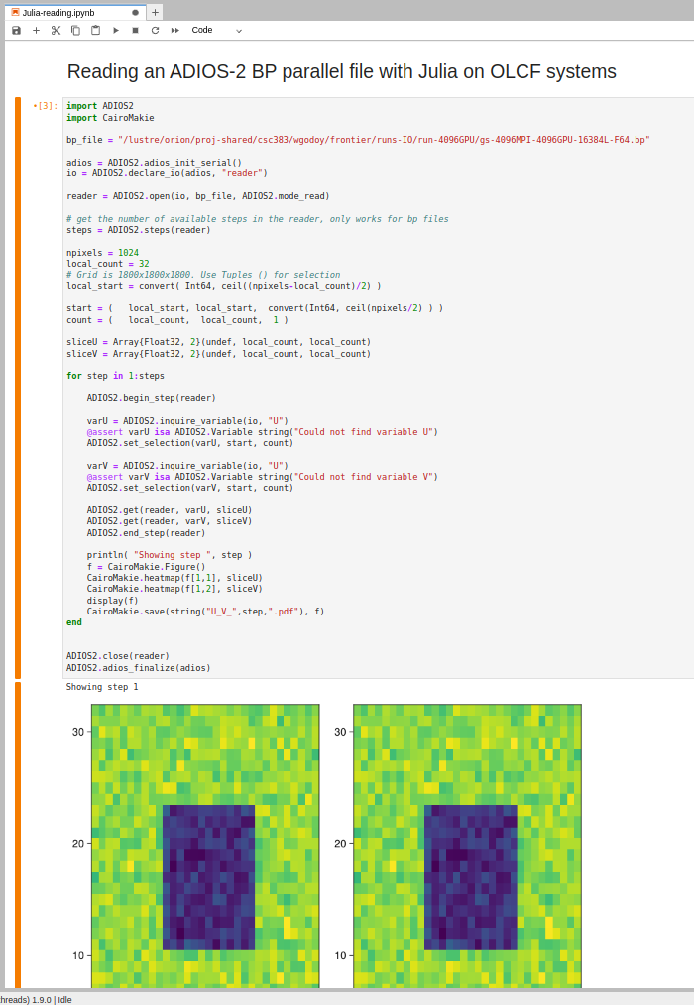
Data analysis on JupyterHub at OLCF
https://jupyter.olcf.ornl.gov/
We launched a Julia kernel on JupyterHub to read and analyze data
We read with ADIOS2.jl and visualize with Makie.jl
JIT and TTFX (time to first plot) can be a nuance
Pluto.jl?
Godoy, W. F., Podhorszki, N., Wang, R., Atkins, C., Eisenhauer, G., Gu, J., ... & Klasky, S. (2020). Adios 2: The adaptable input output system. a framework for high-performance data management. SoftwareX, 12, 100561. https://doi.org/10.1016/j.softx.2020.100561
Notes:
Vendor gaps

Slide 25
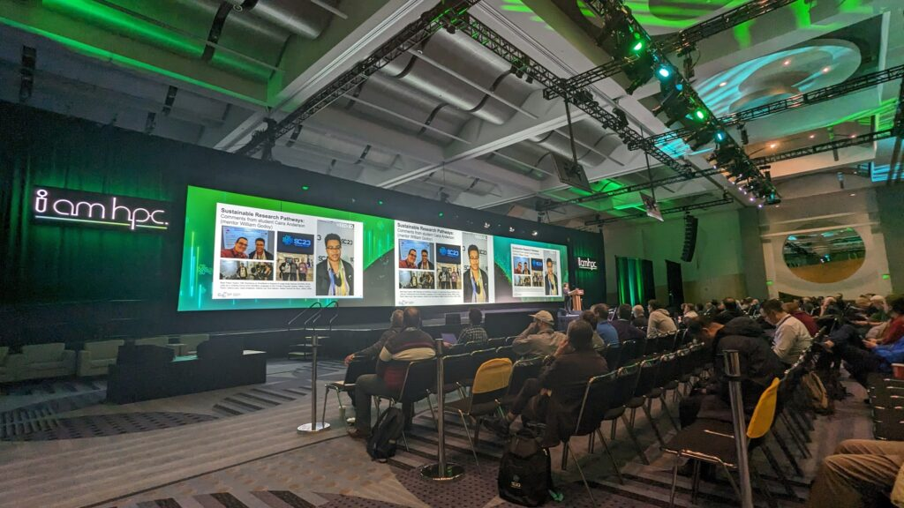
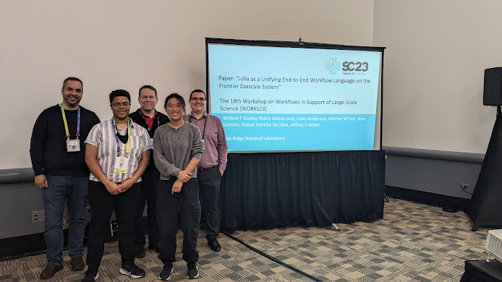



Recent efforts
https://www.youtube.com/watch?v=E2a7jXFp21Y&t=1590s
Investigate new approaches in the post-ECP landscape: Julia for HPC, LLMs for HPC
Recent interest in the high-productivity + high-performance space
Enabled me to mentor in our internship program for the last 3 years (Intern got prestigious DOE CGSF fellowship)
Build a “Julia for HPC” community https://juliaparallel.org/resources/
Explore LLMs for scientific languges
https://shinstitute.org/srp-mentor-spotlight
Highlights:
Building Julia for HPC research and community activities: tutorials, papers, SC BoFs 22/23, SC24 Tutorial
2023 IPDPS HIPS workshop paper
2023 ICPP P2S2 paper on generative AI for HPC kernels
Best Paper at the SC23 WORKS workshop
D-HPC Workshop at SC23

Slide 26






Julia HPC Efforts
Projects:
External Engagements with Julia HPC
Monthly meetings with stakeholders
JuliaCon 2022/2023 HPC minisymposium
Julia HPC Position paper in the works
ECP BoF Session on Rapid Prototyping for HPC using Julia, Python Numba, Flang
SC22/23 BoF “Julia for HPC”
OLCF/NERSC Tutorials (this week)
Upcoming SC24 Tutorial
Internal Engagements
Tutorials at ORNL Software and Data Expo
Julia Workshop for ORNL Science
OLCF User Call: Julia for HPC
SC22
SC23
Notes:
Add external collaborators

Slide 27







Community Efforts in HPC
HPC “backends”:
https://juliagpu.org/: AMDGPU.jl , CUDA.jl OneAPI.jl , Metal.jl
KernelAbstractions.jl, JACC.jl
MPI.jl
Threads (part of Base)
ADIOS2.jl , HDF5.jl
Monthly HPC Call (Valentin Churavy, MIT)
Porting miniWeather App to Julia (Youngsung Kim, Hyun Kang, and Sarat Sreepathi, CSED)
Julia + Sunway + QC at SC22
https://github.com/omlins/julia-gpu-course
Top15 most popular packages
https://enccs.github.io/Julia-for-HPC
https://sciml.ai/
ECP ExaSDG on Summit
https://github.com/CliMA
https://github.com/SunnySuite/Sunny.jl
https://docs.dftk.org/stable
https://juliaastro.github.io/dev
https://github.com/JuliaParallel
Notes:
Vendor gaps

Slide 28
Contents
Welcome
Julia’s value proposition for science: LLVM + Coordinated Ecosystem
Update: Efforts in HPC
Resources: where to get started?
Acknowledgments

Slide 29

Where to get started?
Pick a gentle tutorial: https://techytok.com/from-zero-to-julia/
https://github.com/ornl-training/julia-basics (training by WF Godoy & Philip Fackler) OLCF Tutorial: https://juliaornl.github.io/TutorialJuliaHPC/applications/GrayScott/01-Solver.html
Use VS Code as the official IDE + debugger
JuliaCon talks are available on YouTube
https://discourse.julialang.org/ Stackoverflow might be outdated, https://julialang.slack.com/
Julia docs and standard library: https://docs.julialang.org/en/v1/
Learn: Project.toml, Testing.jl @testset @test, Pluto.jl , CUDA.jl/AMDGPU.jl , JACC.jl, KernelAbstractions.jl, LinearAlgebra.jl , Makie.jl , Plots.jl and Flux.jl (AI/ML), how to build a sysimage with PackageCompiler.jl
Pick problems you care about! Let us know if you’re interested in a hackathon.
Patience and community reliance: learning a language is a big investment.
https://williamfgc.github.io/programming/scientific-computing/2020/07/22/first-project-julia-language.html

Slide 30



GitHub Copilot (GPT-3/Codex), Large Language Models + Julia
Julia is a more targeted language (like Fortran)
Julia + LLMs are a powerful combination for productivity
GitHub Copilot on VS Code $100/year/account
Compared several languages + parallel programming models
C++, Fortran, Python, Julia. Fortran and Julia scored high!

Slide 31





























S4PST: Stewardship of Programming Systems and Tools (2024-2029)
PI: Keita Teranishi (ORNL), Co-PIs: Pedro Valero-Lara, William F Godoy
8 National Laboratories:
Oak Ridge National Laboratory
Argonne National Laboratory
Lawrence Livermore National Laboratory
Lawrence Berkeley National Laboratory
Sandia National Laboratories
Brookhaven National Laboratory
Los Alamos National Laboratory
SLAC National Accelerator Laboratory
University Partners:
University of Delaware
Massachusetts Institute of Technology
Collaborations:
Louisiana State University
Pacific Northwest National Laboratory
Carnegie Mellon University
University of Tennessee, Knoxville
Stanford University
Other 6 NSSGT projects
Future HPC Expert

Slide 32


Thanks to the audience!
If you are ready to explore Julia, we are ready to help
https://scientificcoder.com/my-target-audience
Acknowledgements
Co-organizers:
William F Godoy
Pedro Valero-Lara
Het Mankad
Steven E. Hahn
Keita Teranishi
Jeffrey S Vetter
Rafael Ferreira da Silva
Corinna Thomas
Donna Wilkerson (retired)
Virtual Tutorials:
Suzanne Parete-Koon (OLCF)
Helen He (NERSC)
Johannes Blascke (NERSC)
Mose Giordano (UCL, UK)
Sponsors:
The CSMD ACSR Section
The ASCR Bluestone Project
CASS PESO and S4PST projects
OLCF/NERSC

